Slide 1

Fun AcTIVITY
Presented By- Mrunal Vilas Padalkar Soumyadip Mondal

Slide 2

Activity-1: visual puzzles

Slide 3

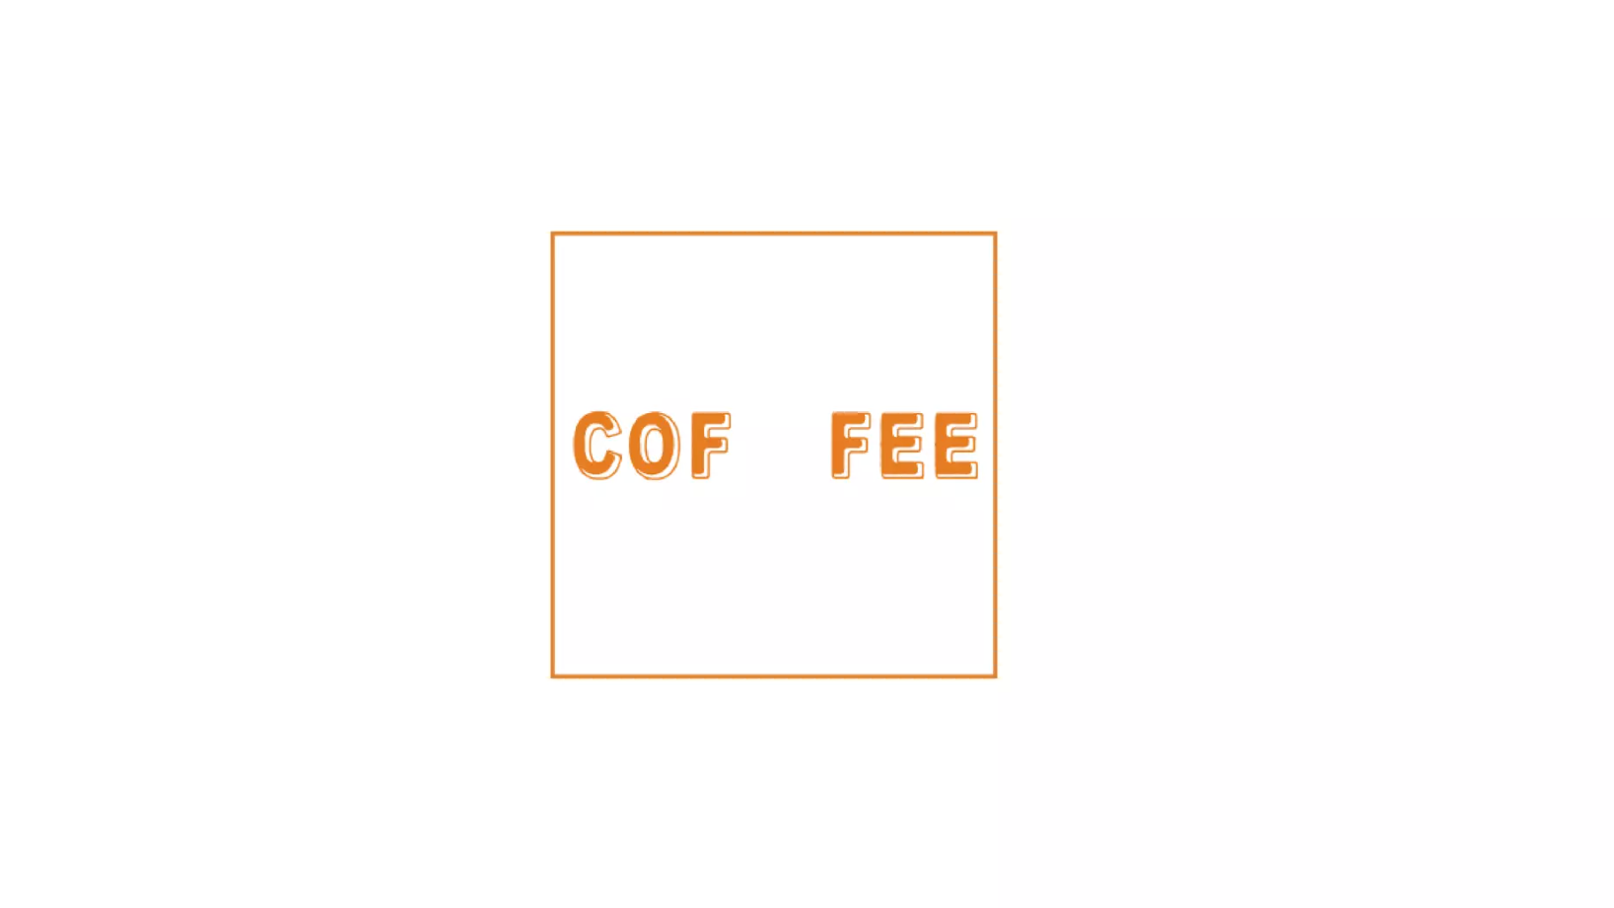
puzzles

Slide 4
Answer
Coffee Break

Slide 5

puzzles

Slide 6
ANSWER
Read between the lines

Slide 7

puzzles

Slide 8
Answer
Broken Promise

Slide 9

puzzles

Slide 10
Answer
Love at first sight

Slide 11

puzzles

Slide 12
Answer
Balanced Diet

Slide 13

puzzles

Slide 14
Answer
Mixed emotions

Slide 15

puzzles

Slide 16
Answer
First aid

Slide 17

puzzles

Slide 18
Answer
Food for thought

Slide 19

puzzles

Slide 20
Answer
Out of the blue

Slide 21

puzzles

Slide 22
Answer
Bird’s eye view

Slide 23

puzzles

Slide 24
Answer
Scrambled eggs

Slide 25

puzzles

Slide 26
Answer
Once in a blue moon

Slide 27

puzzles

Slide 28
Answer
Missunderstood

Slide 29

puzzles

Slide 30
Answer
Top secret

Slide 31

puzzles

Slide 32
Answer
Crystal clear

Slide 33

puzzles

Slide 34
Answer
Square Root

Slide 35
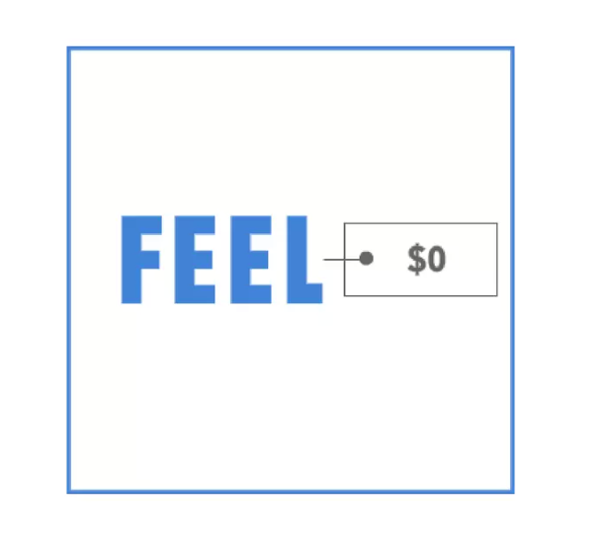
puzzles

Slide 36
Answer
Feel free

Slide 37

puzzles

Slide 38
Answer
Eye shadow

Slide 39

puzzles

Slide 40
Answer
Hidden meaning

Slide 41

puzzles

Slide 42
Answer
Working overtime

Slide 43

puzzles

Slide 44
Answer
Time is money

Slide 45

puzzles

Slide 46
Answer
Kingpin

Slide 47

puzzles

Slide 48
Answer
One in a million

Slide 49

puzzles

Slide 50
Answer
Live in peace

Slide 51

puzzles

Slide 52
Answer
You are fired!!!

Slide 53

puzzles

Slide 54
Answer
Making ends meet

Slide 55

Activity-2: Guess the movie

Slide 56

GuesS the movie

Slide 57
Answer
Ice Age

Slide 58

GuesS the movie

Slide 59
Answer
Wall-E

Slide 60

GuesS the movie/Actor

Slide 61
Answer
Tere Naam/ Salman Khan

Slide 62

GuesS the movie

Slide 63
Answer
Chak De India!

Slide 64

GuesS the movie/Actor

Slide 65
Answer
Ghajini/Aamir Khan

Slide 66

GuesS the movie/ACTOR

Slide 67
Answer
Raab Ne Bana Di Jodi/Shahrukh Khan

Slide 68

GuesS the movie

Slide 69
Answer
Chennai Express

Slide 70
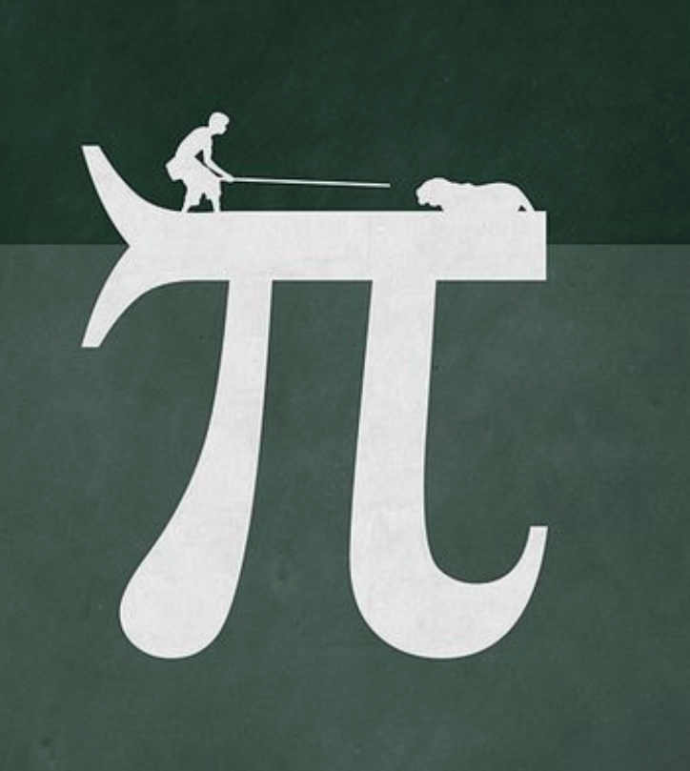
GuesS the movie

Slide 71
Answer
Life Of Pi

Slide 72

GuesS the movie

Slide 73
Answer
Titanic

Slide 74
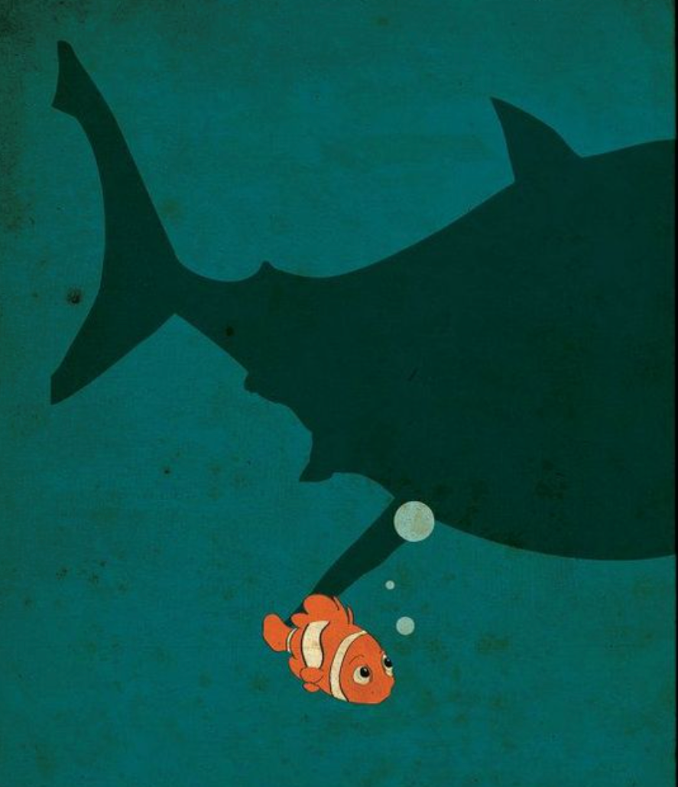
GuesS the movie

Slide 75
Answer
Finding Nemo

Slide 76

GuesS the movie/Actor

Slide 77
Answer
Baashha/Rajnikanth

Slide 78

GuesS the movie/Actor

Slide 79
Answer
Hera Pheri/Akshay Kumar

Slide 80

Activity-3: SPOT the Mistake

Slide 81
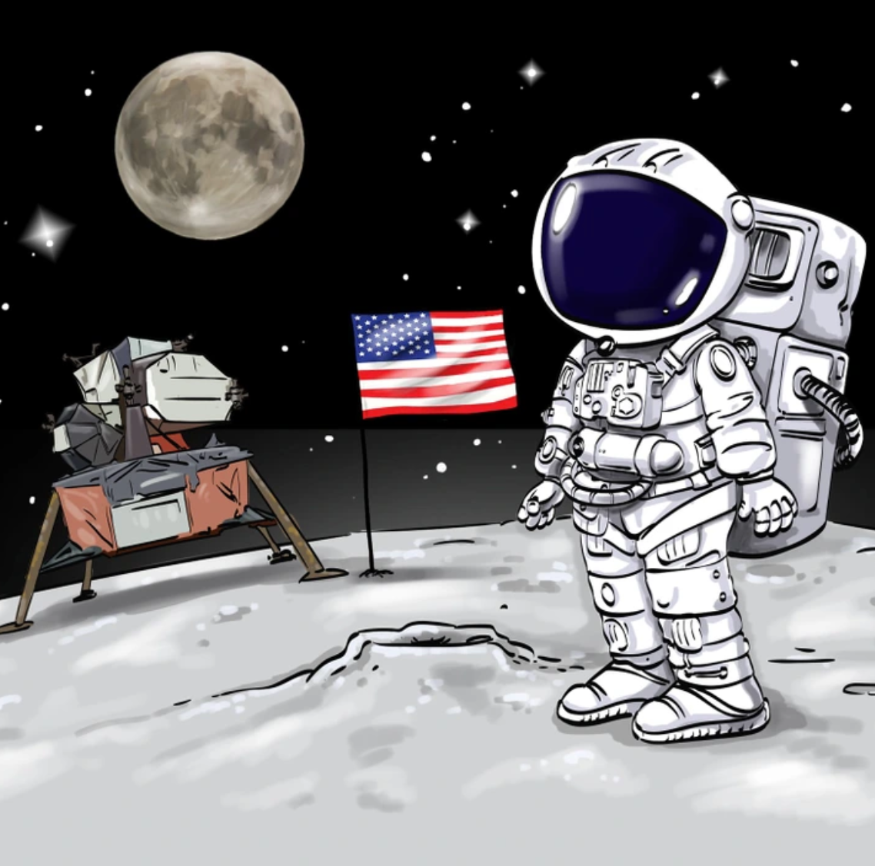
SPOT THE MISTAKE

Slide 82
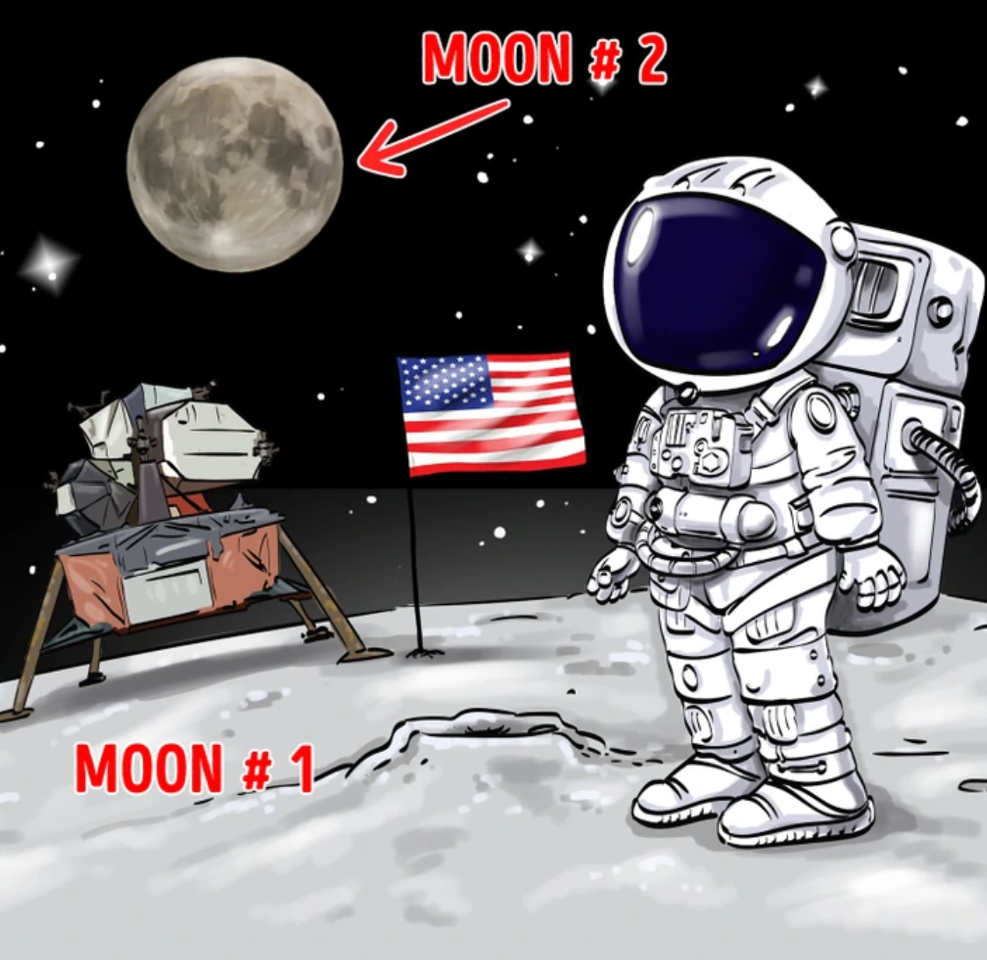
Answer

Slide 83
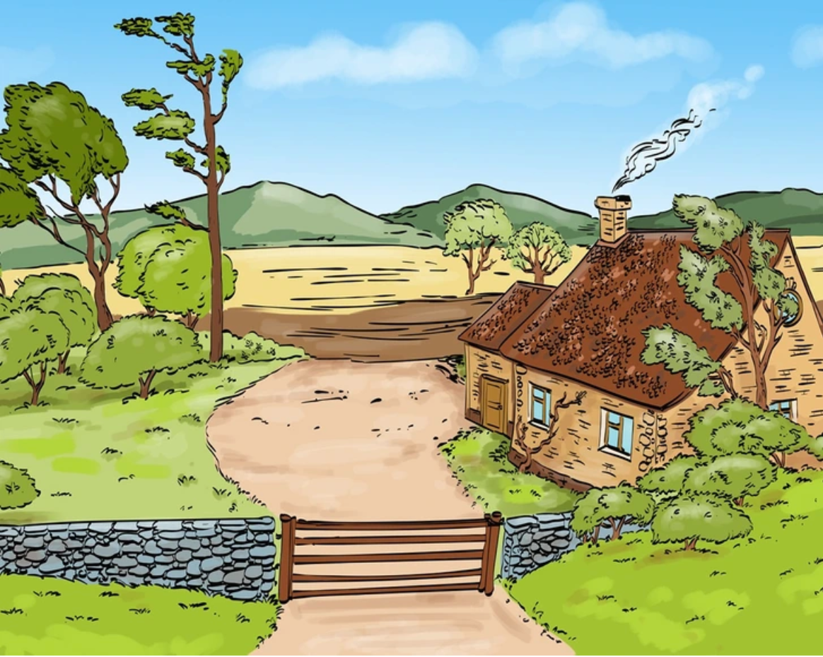
SPOT THE MISTAKE

Slide 84
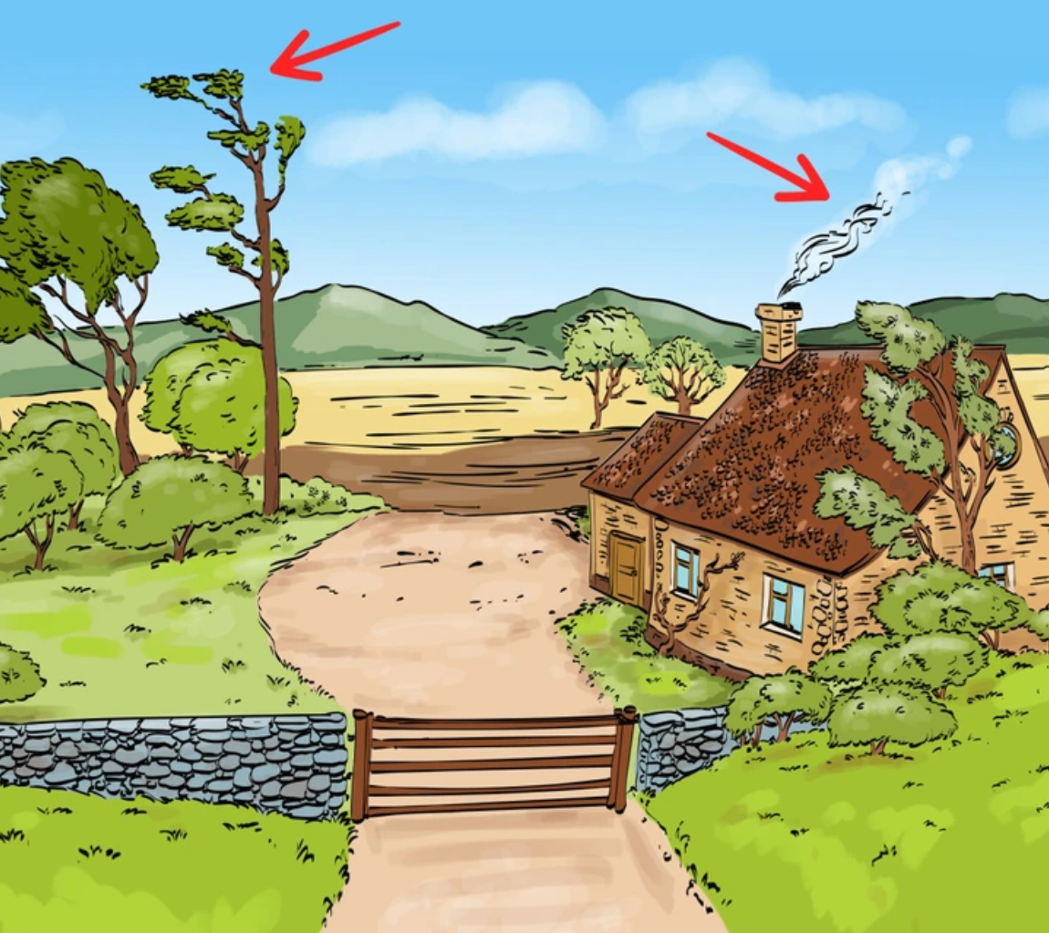
Answer

Slide 85
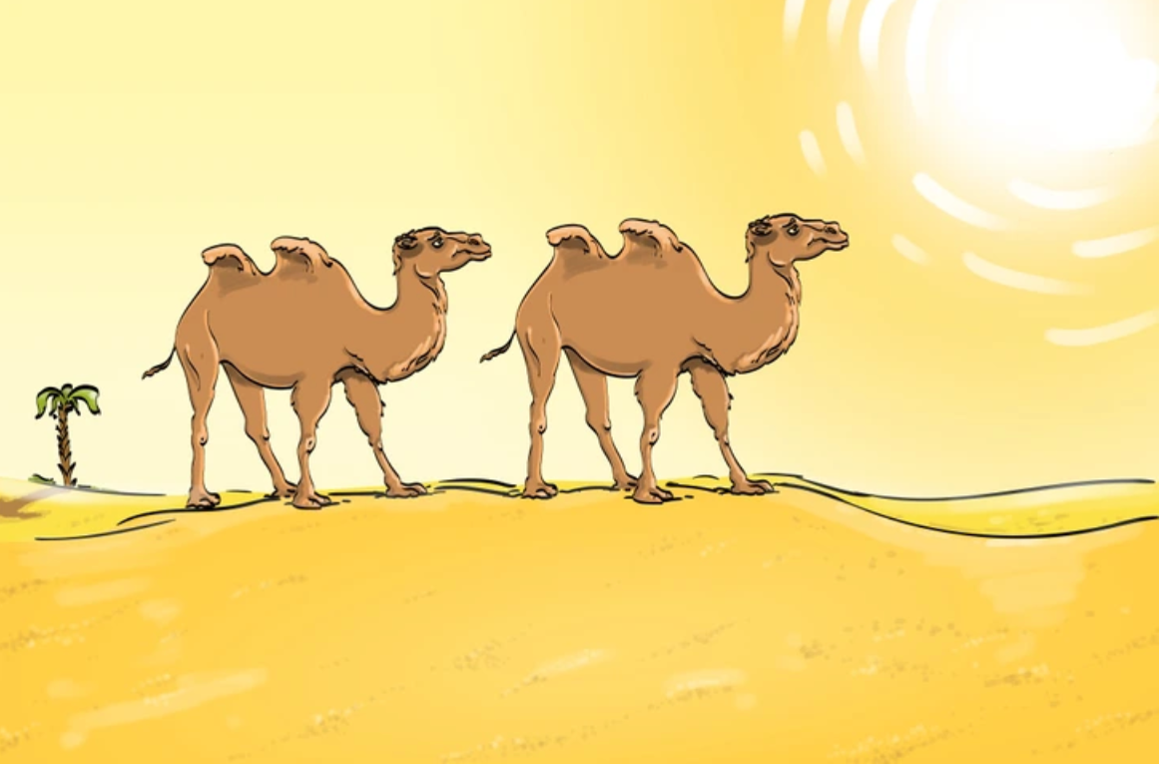
SPOT THE MISTAKE

Slide 86
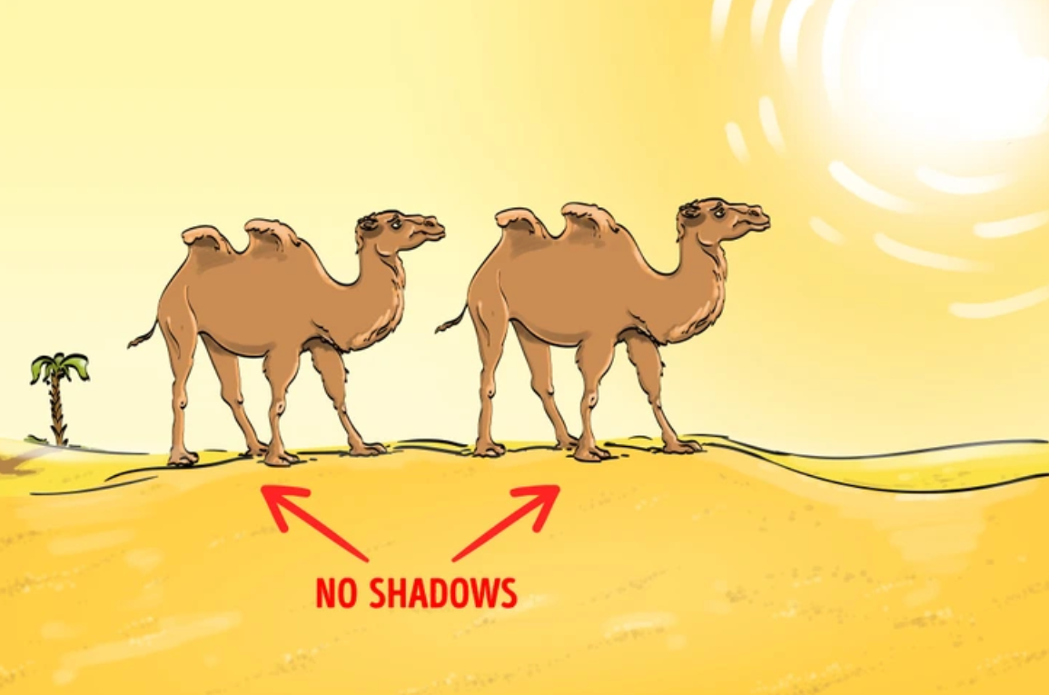
Answer

Slide 87
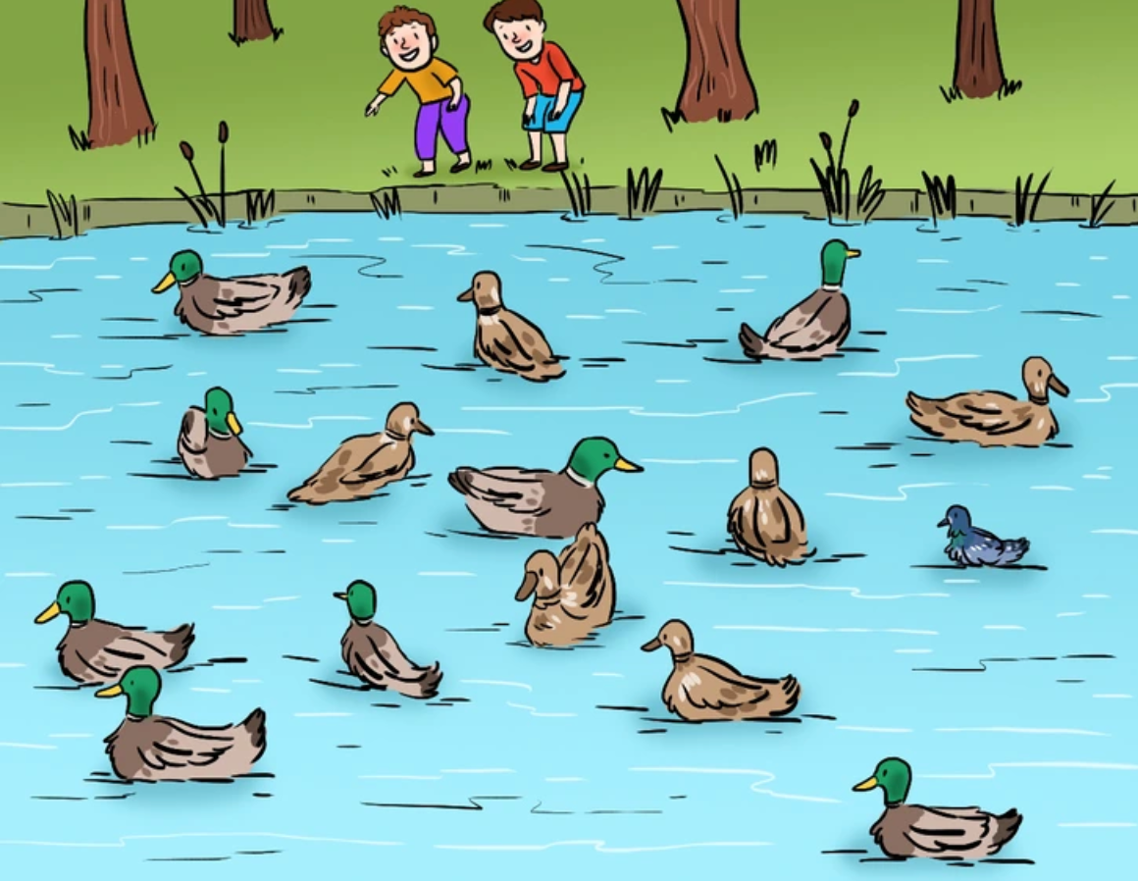
SPOT THE MISTAKE

Slide 88
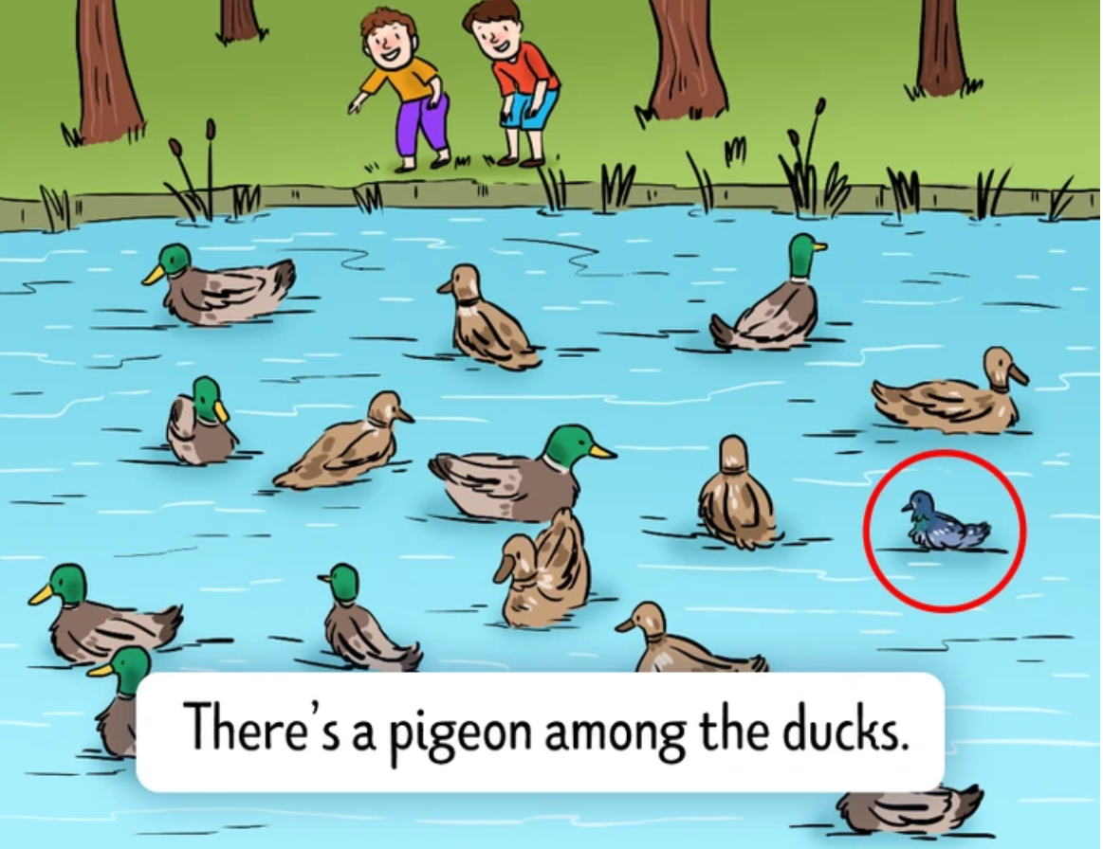
Answer

Slide 89
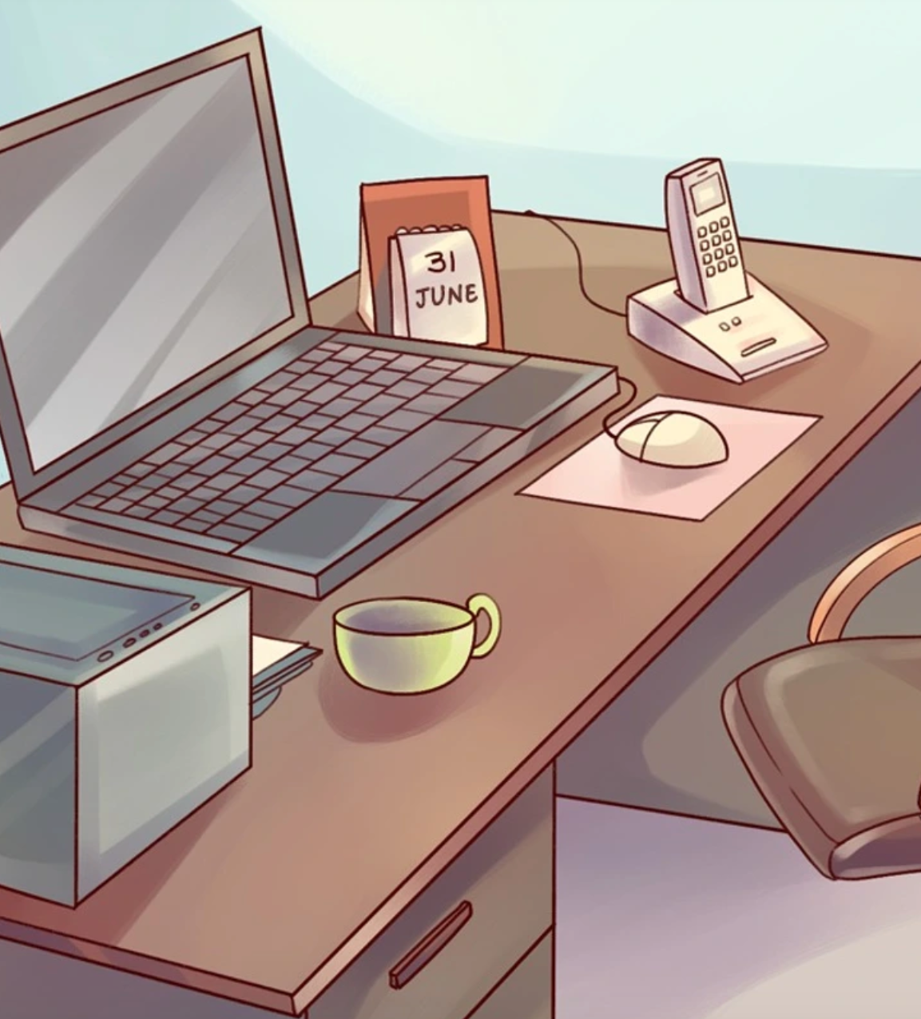
SPOT THE MISTAKE

Slide 90
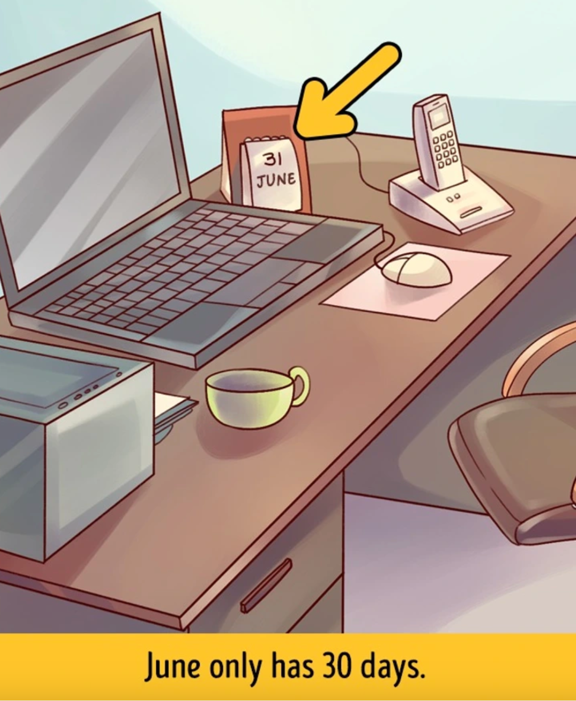
Answer

Slide 91
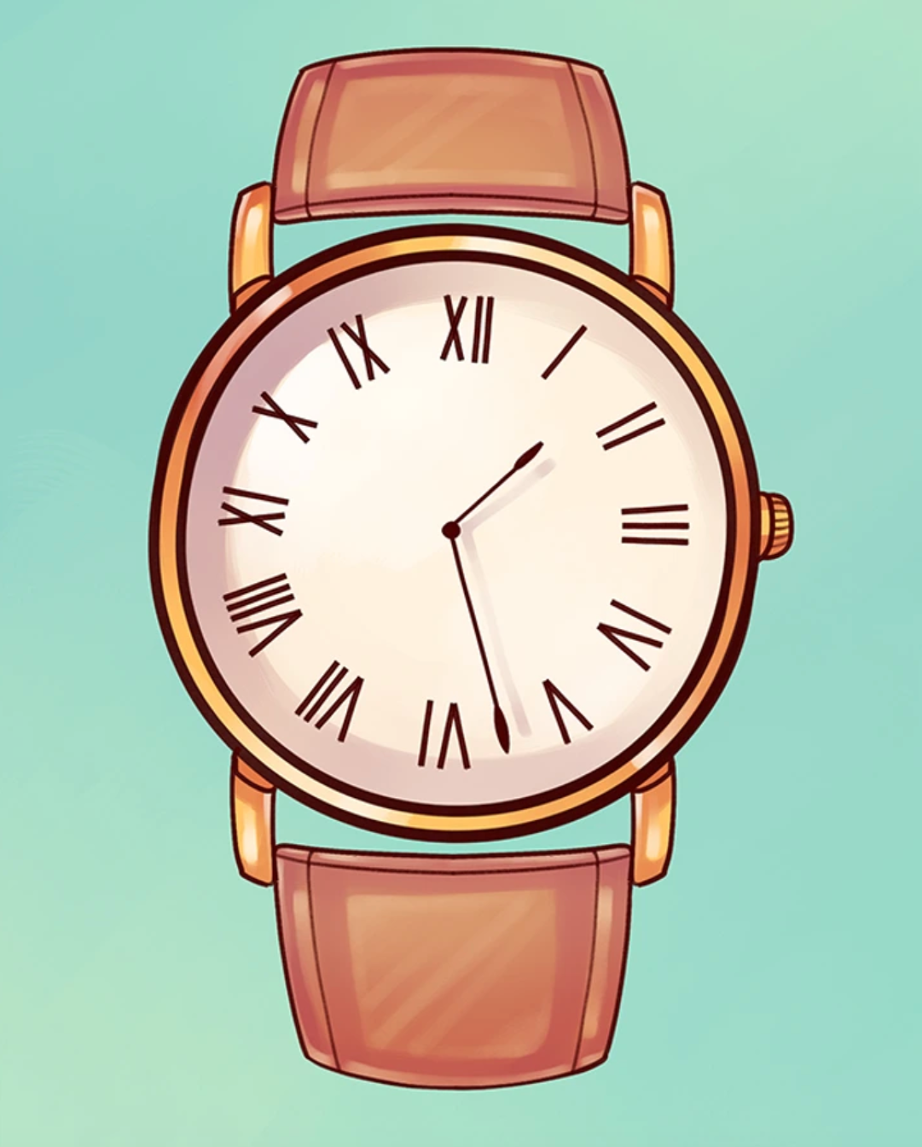
SPOT THE MISTAKE

Slide 92
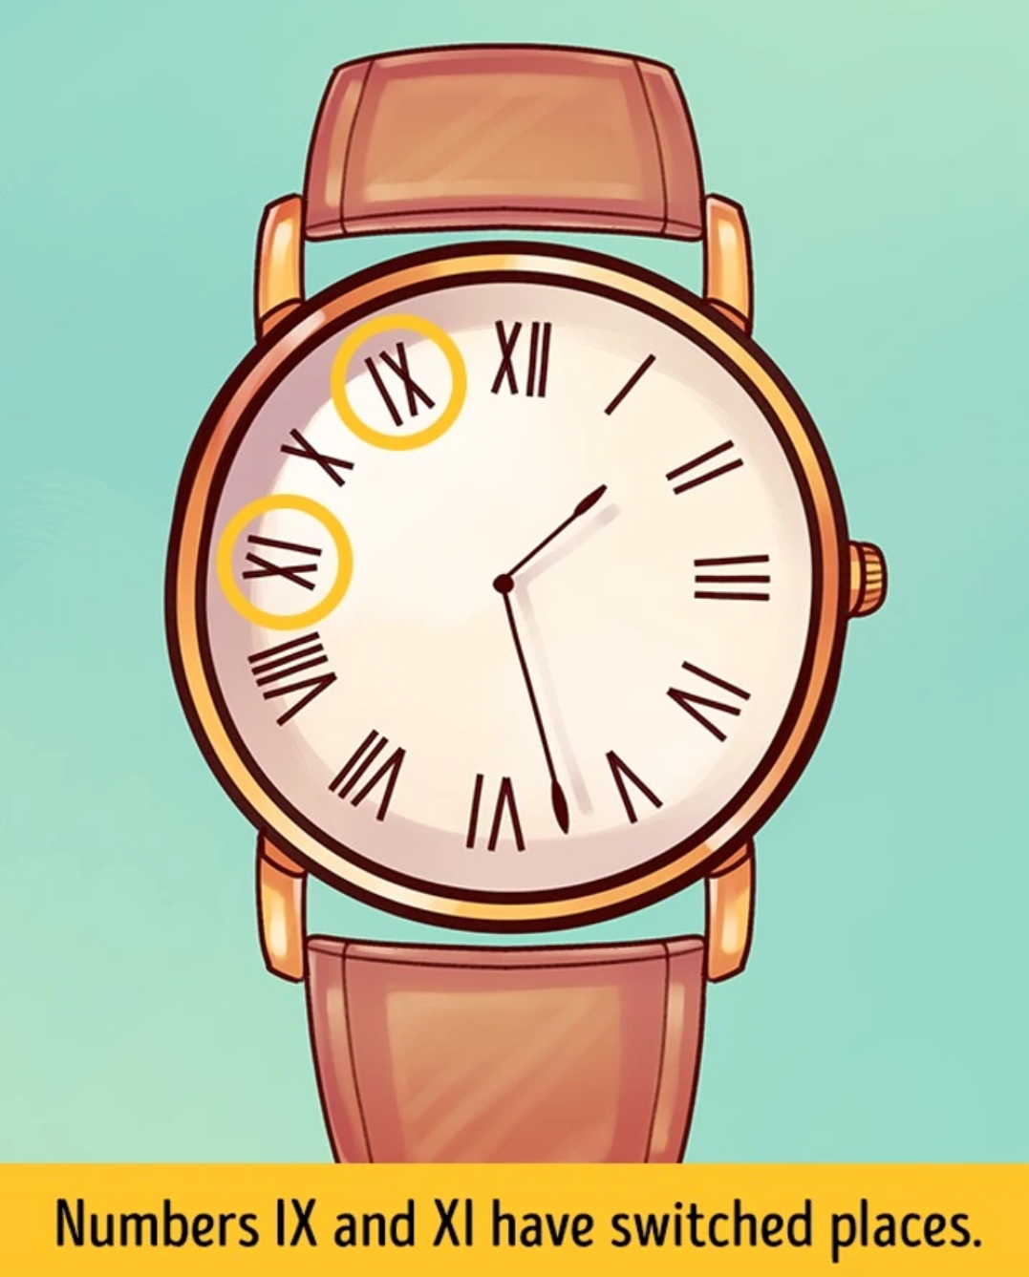
Answer

Slide 93
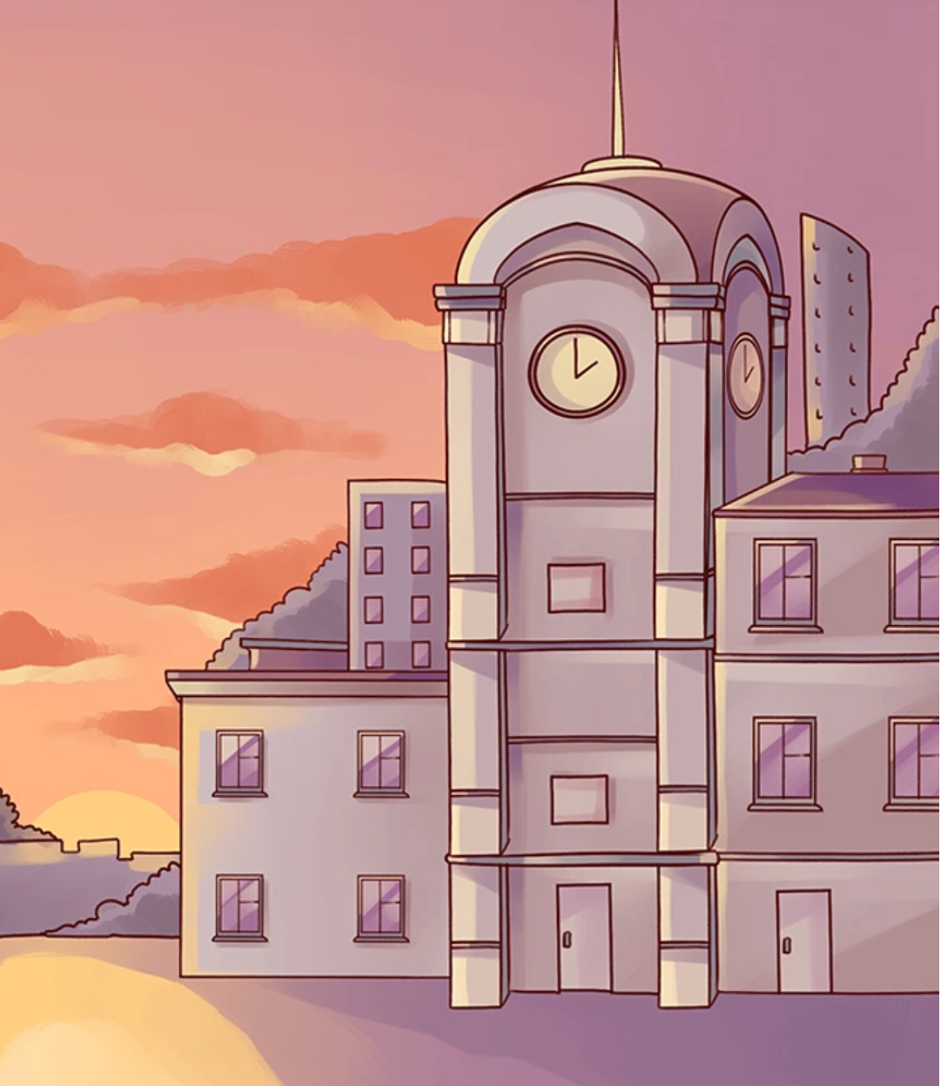
SPOT THE MISTAKE

Slide 94
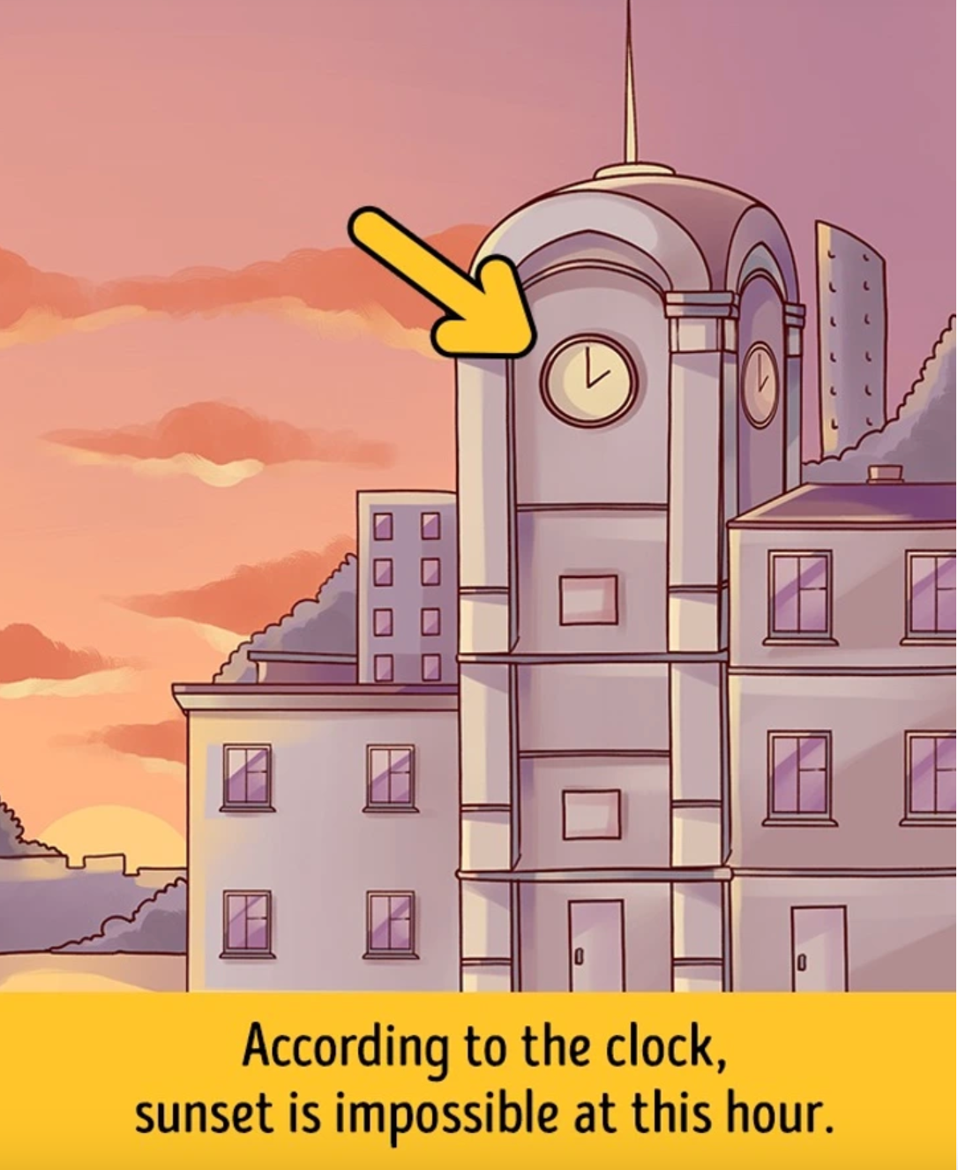
Answer

Slide 95

SPOT THE MISTAKE

Slide 96
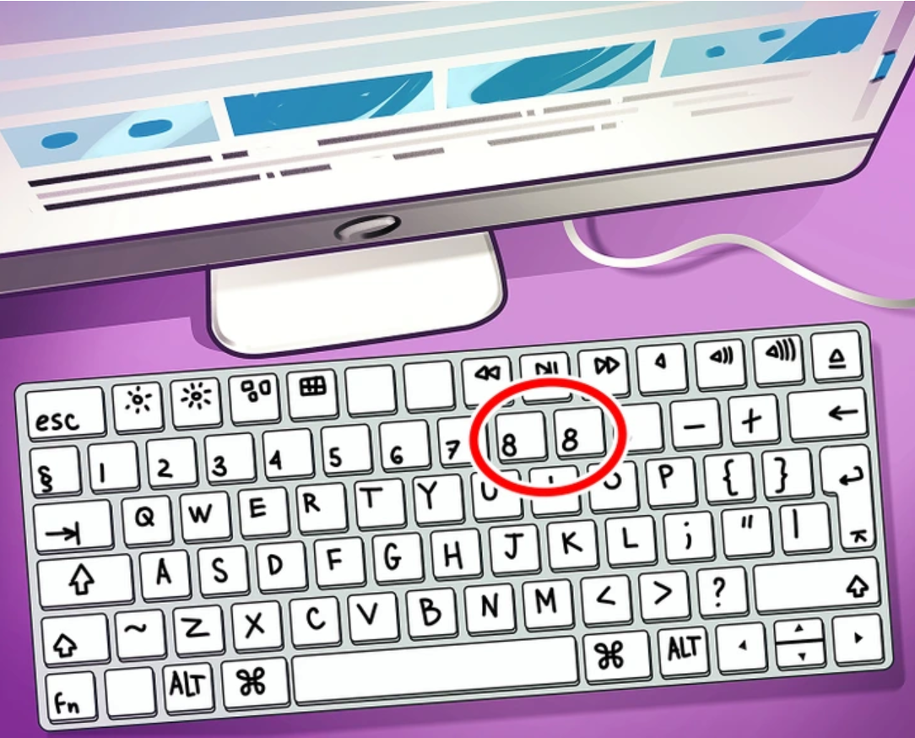
Answer

Slide 97

SPOT THE MISTAKE

Slide 98
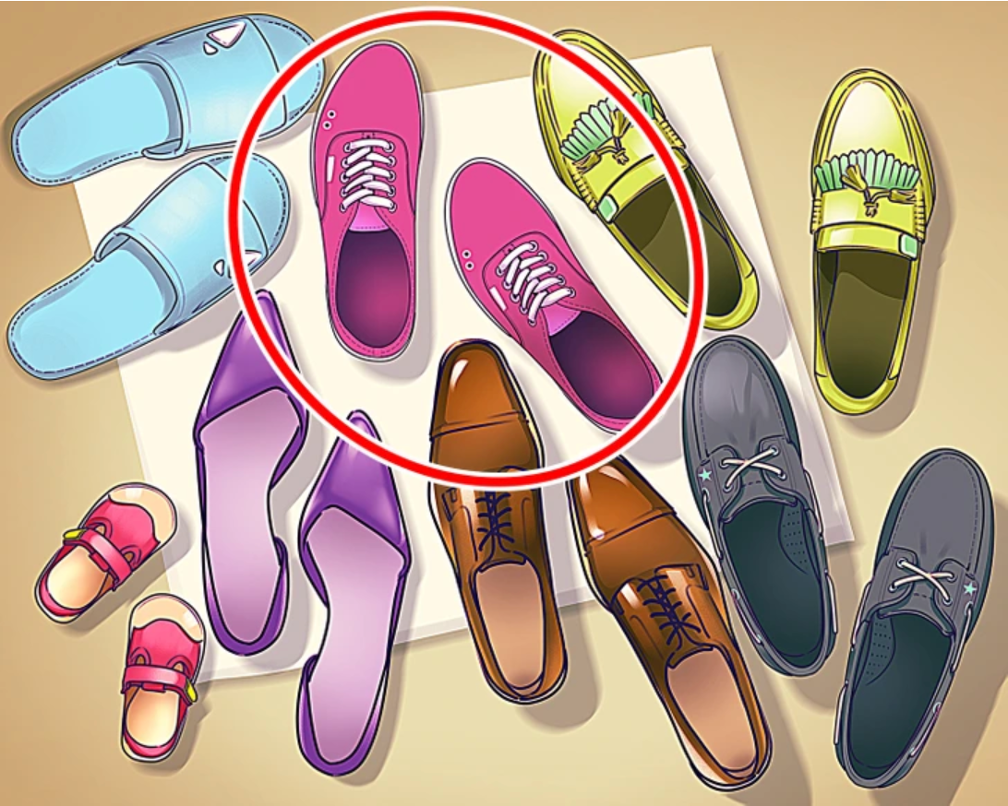
Answer

Slide 99

SPOT THE MISTAKE

Slide 100

Answer

